Slide 1

7th Grade Math
Unit 11, Lesson 4 Features of Proportional Relationships Volume 2, pg. 164

Slide 2


Benchmark
MA.7.AR.4.1
Determine whether two quantities have a proportional relationship by examining a table, graph, or written description.
volume 2, pg. 164

Slide 3
Integrated Mathematical Thinking and Reasoning Standards
MA.K12.MTR.2.1 Demonstrate understanding by representing problems in multiple ways.
MA.K12.MTR.5.1 Use patterns and structure to help understand and connect mathematical concepts.
MA.K12.MTR.7.1 Apply mathematics to real-world contexts.
volume 2, pg. 164

Slide 4

Learning Targets
I can determine if two quantities have a proportional relationship.
I can relate tables and graphs that represent the same relationship between two quantities in a real-world context.
volume 2, pg. 164

Slide 5

Warm-Up
volume 2, pg. 165

Slide 6
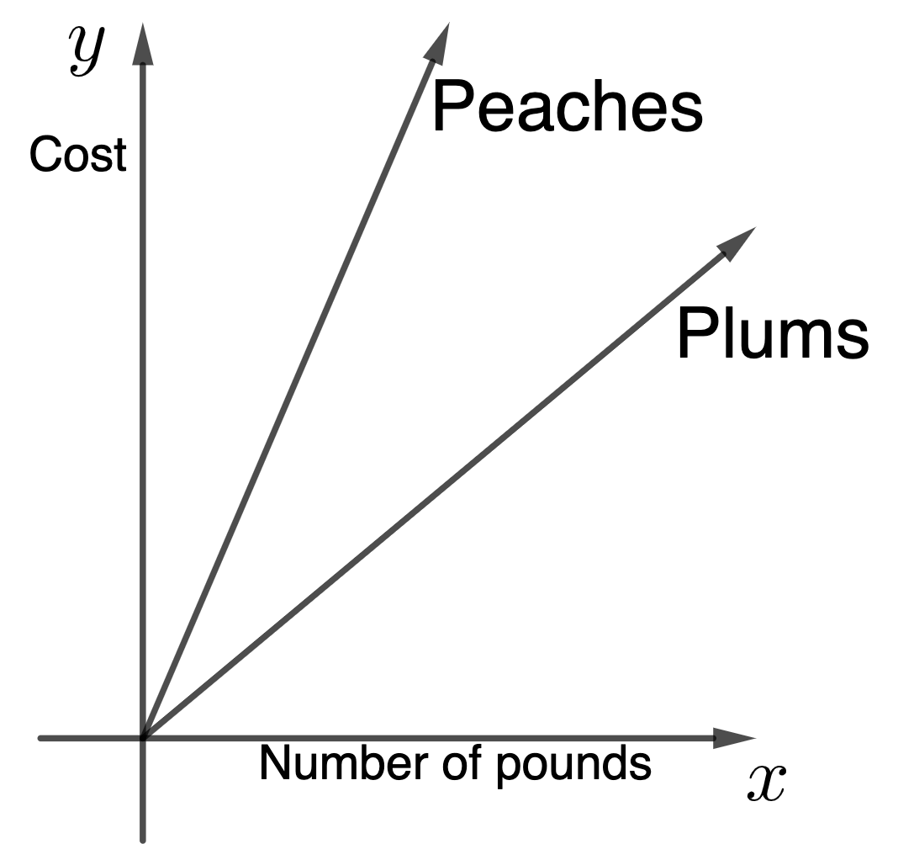
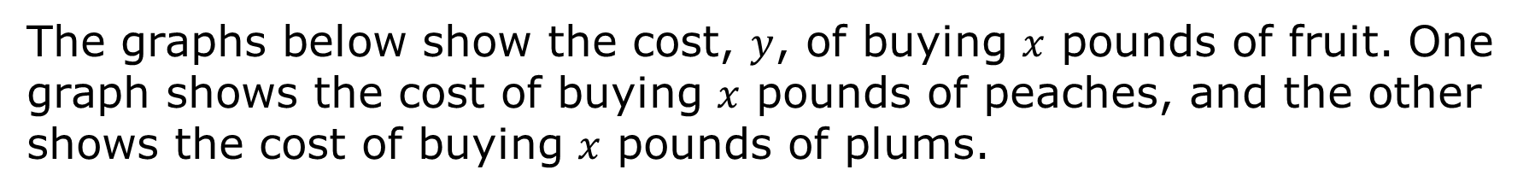
11.4.1 Warm-Up: Notice and Wonder
The graphs below show the cost, $y$, of buying $x$ pounds of fruit. One graph shows the cost of buying $x$ pounds of peaches, and the other shows the cost of buying $x$ pounds of plums.
volume 2, pg. 165

Slide 7
After looking at the relationships graphed, complete the table with one thing you notice and one thing you wonder.
Explain which fruit you think costs more per pound.
One thing I notice is… | One thing I wonder is…
volume 2, pg. 165

Slide 8

Activity
volume 2, pg. 165

Slide 9

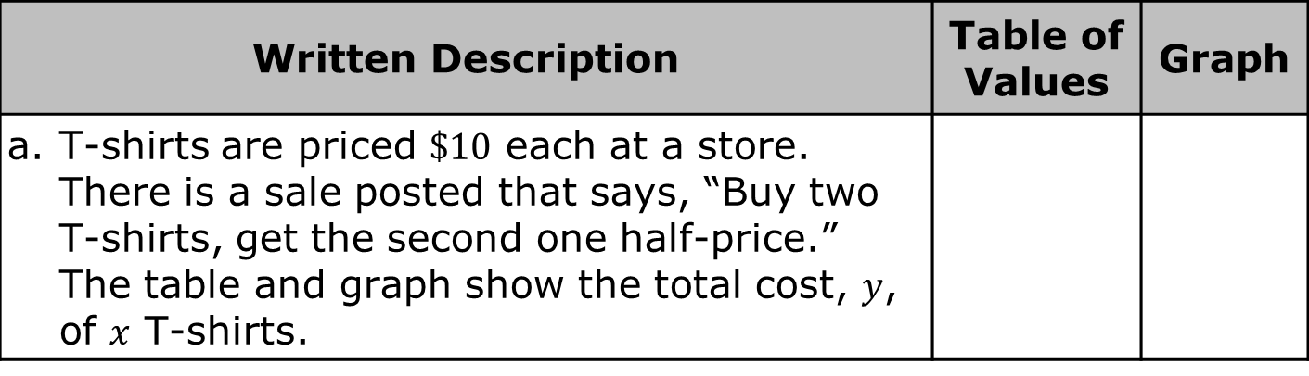
11.4.2 Activity: Card Sort
Several scenarios are described in the chart. Your teacher will give you two sets of cards showing tables and graphs.
Work with your partner to match a table of values and graph to each scenario. Write the matching table number and letter of the graph in the chart.
Written Description | Table of Values | Graph
T-shirts are priced $\$10$ each at a store. There is a sale posted that says, “Buy two T-shirts, get the second one half-price.” The table and graph show the total cost, $y$, of $x$ T-shirts.
volume 2, pg. 165

Slide 10
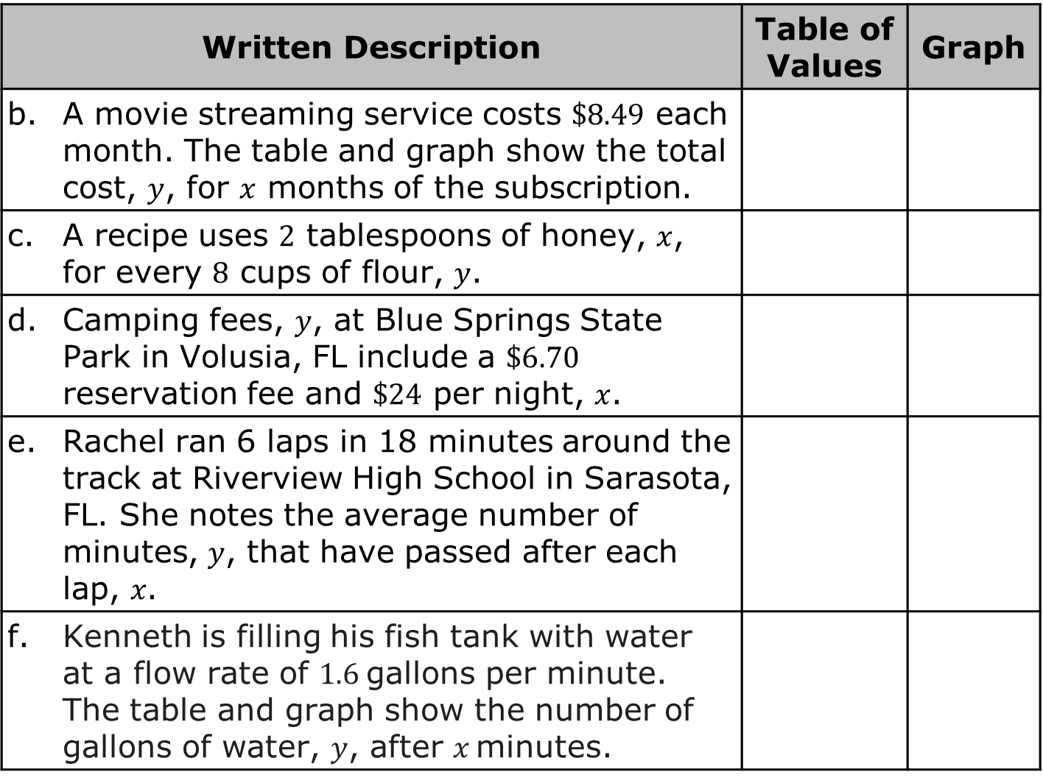
Written Description | Table of Values | Graph
A movie streaming service costs $\$8.49$ each month. The table and graph show the total cost, $y$, for $x$ months of the subscription.
A recipe uses $2$ tablespoons of honey, $x$, for every $8$ cups of flour, $y$.
Camping fees, $y$, at Blue Springs State Park in Volusia, FL include a $\$6.70$ reservation fee and $\$24$ per night, $x$.
Rachel ran 6 laps in 18 minutes around the track at Riverview High School in Sarasota, FL. She notes the average number of minutes, 𝑦, that have passed after each lap, 𝑥.
Kenneth is filling his fish tank with water at a flow rate of 1.6 gallons per minute. The table and graph show the number of gallons of water, 𝑦, after 𝑥 minutes.
volume 2, pg. 165

Slide 11
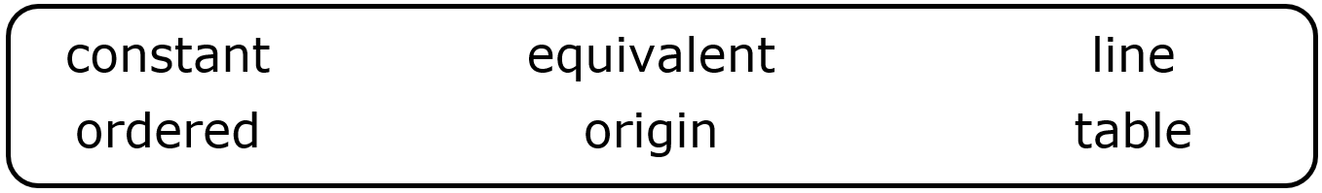
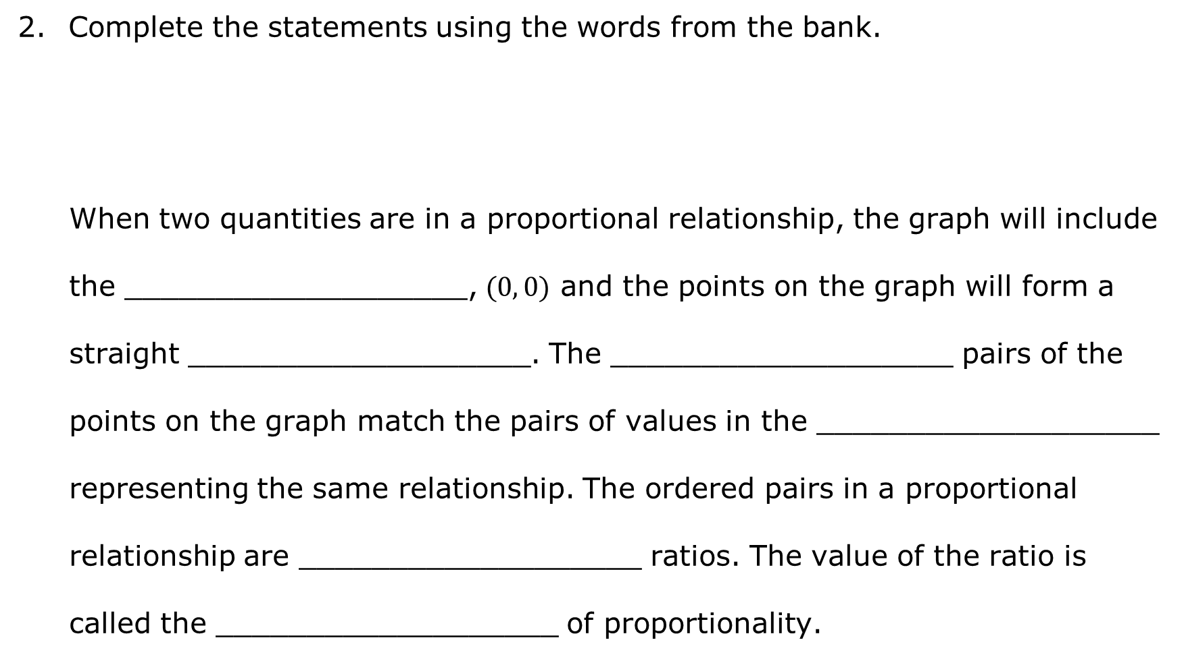
Complete the statements using the words from the bank.
When two quantities are in a proportional relationship, the graph will include the ___________________, $(0, 0)$ and the points on the graph will form a straight ___________________. The ___________________ pairs of the points on the graph match the pairs of values in the ___________________ representing the same relationship. The ordered pairs in a proportional relationship are ___________________ ratios. The value of the ratio is called the ___________________ of proportionality.
volume 2, pg. 166

Slide 12
Work with your partner to determine which scenarios from the card sort represent proportional relationships using the matching tables and graphs. Write the letter P next to the written description in the chart for each relationship that is proportional.
Use Graph D and the context it represents to complete the following parts with your partner.
Discuss why, for this context, it makes sense that every point on the line shown is possible.
Explain whether you think the graph representing this relationship will continue increasing every minute that passes.
volume 2, pg. 166

Slide 13
Use Graph E and the table it matches to complete the following parts with your partner.
The points on Graph E form a straight line, but the situation does not represent a proportional relationship. Explain why it does not represent a proportional relationship.
Use at least two ordered pairs from the table of values that matches Graph E to show why this relationship is not proportional.
volume 2, pg. 166

Slide 14

Bring It Together
volume 2, pg. 167

Slide 15


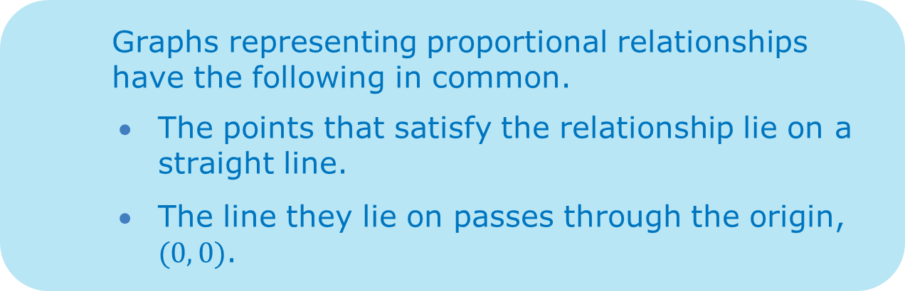
11.4.3 Bring It Together: Determining If a Relationship Is Proportional
Graphs representing proportional relationships have the following in common.
The points that satisfy the relationship lie on a straight line.
The line they lie on passes through the origin, $(0, 0)$.
Tables representing proportional relationships have the following in common.
Each row in the table shows a ratio of the two quantities in the relationship.
All of the ratios in the relationship are equivalent.
volume 2, pg. 167

Slide 16

Your Turn
volume 2, pg. 167

Slide 17
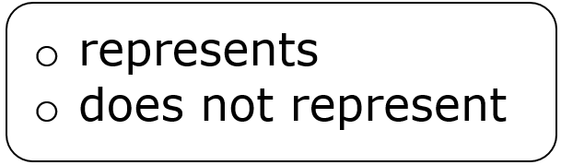
11.4.4 Your Turn!
A graph is shown.
Complete the statement
The graph a proportional relationship between two quantities.
Explain your selection for Part A.
volume 2, pg. 167

Slide 18
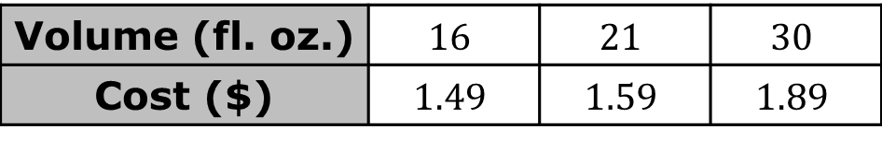
Fountain drinks at Wawa are priced by size. The volume in fluid ounces (fl. oz.) and price in dollars ($), before tax, for each size is shown in the table.
Complete the statement
The table a proportional relationship between two quantities.
Explain your selection for Part A.
Volume (fl. oz.) | $$16$$ | $$21$$ | $$30$$
Cost ($) | $$1.49$$ | $$1.59$$ | $$1.89$$
volume 2, pg. 168

Slide 19

Wrap-Up
volume 2, pg. 168

Slide 20
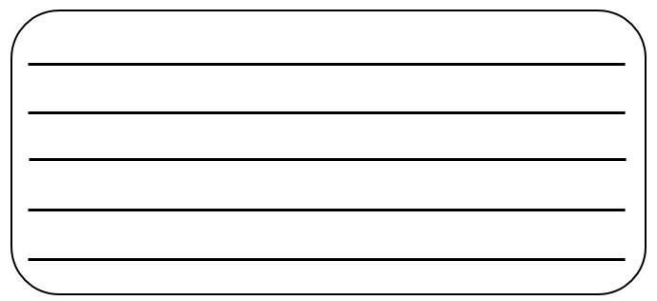
11.4.5 Wrap-Up: Cool Down
Your friend is absent today and will need the notes from class. Write a quick note to help them understand how to determine if two quantities have a proportional relationship.
volume 2, pg. 168

